Slide 1

Pennant Technologies Private Limited
Multi-Threading in Java

Slide 4
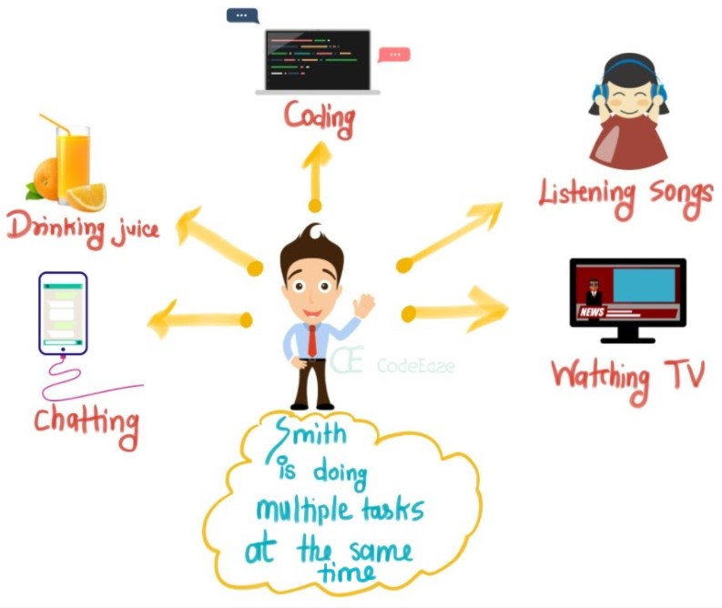
Multitasking

Slide 5
MULTI TASKING
Multitasking is a process of executing multiple tasks simultaneously. We use multitasking to utilize the CPU. Multitasking can be achieved in two ways:
Process-based Multitasking (Multiprocessing)
Thread-based Multitasking (Multithreading)
1) Process-based Multitasking (Multiprocessing)
Each process has an address in memory. In other words, each process allocates a separate memory area.
A process is heavyweight.
Cost of communication between the process is high.
Switching from one process to another requires some time for saving and loading registers, memory maps, updating lists, etc.
2) Thread-based Multitasking (Multithreading)
Threads share the same address space.
A thread is lightweight.
Cost of communication between the thread is low.
Note: At least one process is required for each thread.

Slide 6
MULTI THREADING IN JAVA
Multithreading in Java is a process of executing multiple threads simultaneously.
A thread is a lightweight sub-process, the smallest unit of processing. Multiprocessing and multithreading, both are used to achieve multitasking.
However, we use multithreading than multiprocessing because threads use a shared memory area.
They don't allocate separate memory area so saves memory, and context-switching between the threads takes less time than process.
Java Multithreading is mostly used in games, animation, etc.
Advantages of Java Multithreading
1) It doesn't block the user because threads are independent and you can perform multiple operations at the same time.
2) You can perform many operations together, so it saves time.
Threads are independent, so it doesn't affect other threads if an exception occurs in a single thread.

Slide 7
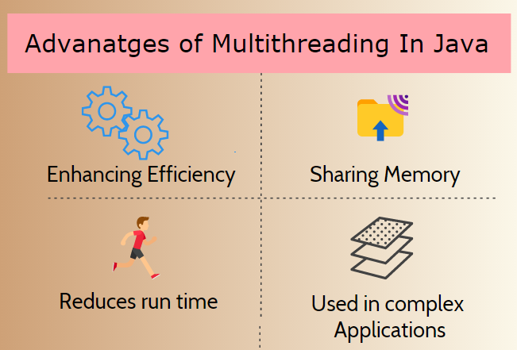

Slide 8
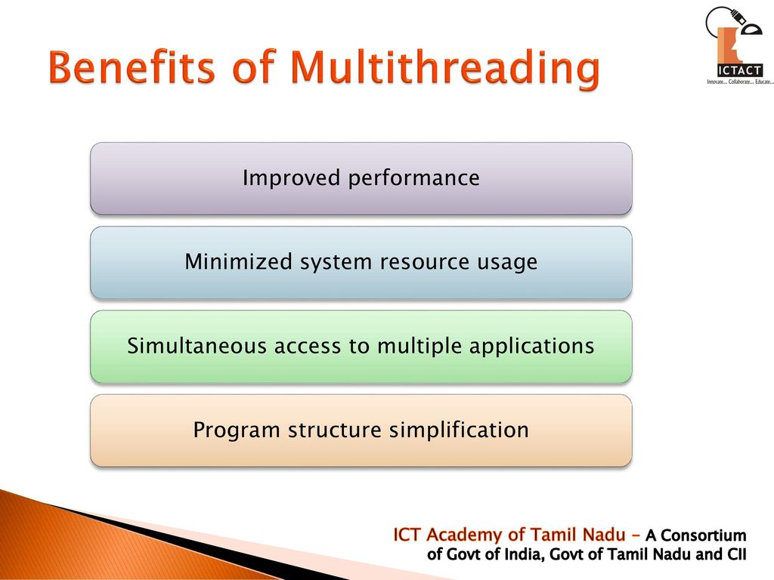

Slide 9
THREAD
A thread is a lightweight subprocess, the smallest unit of processing. It is a separate path of execution.
Threads are independent. If there occurs exception in one thread, it doesn't affect other threads. It uses a shared memory area.
As shown in the above figure, a thread is executed inside the process. There is context-switching between the threads. There can be multiple processes inside the OS, and one process can have multiple threads.
Note: At a time one thread is executed only.
Java provides Thread class to achieve thread programming. Thread class provides constructors and methods to create and perform operations on a thread. Thread class exten

Slide 10
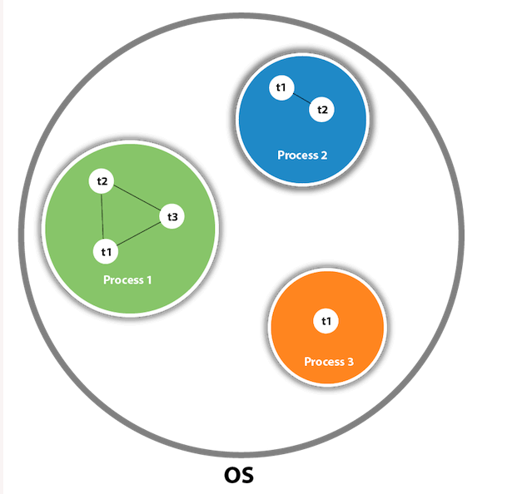

Slide 11
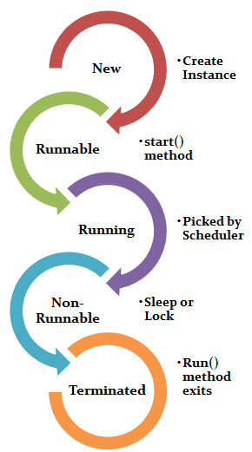

Slide 12
LIFE CYCLE OF A THREAD
A thread can be in one of the five states. According to sun, there is only 4 states in thread life cycle in java new, runnable, non-runnable and terminated. There is no running state.
But for better understanding the threads, we are explaining it in the 5 states.
The life cycle of the thread in java is controlled by JVM. The java thread states are as follows:
1. New
2. Runnable
3. Running
4. Non-Runnable (Blocked)
5. Terminated

Slide 13
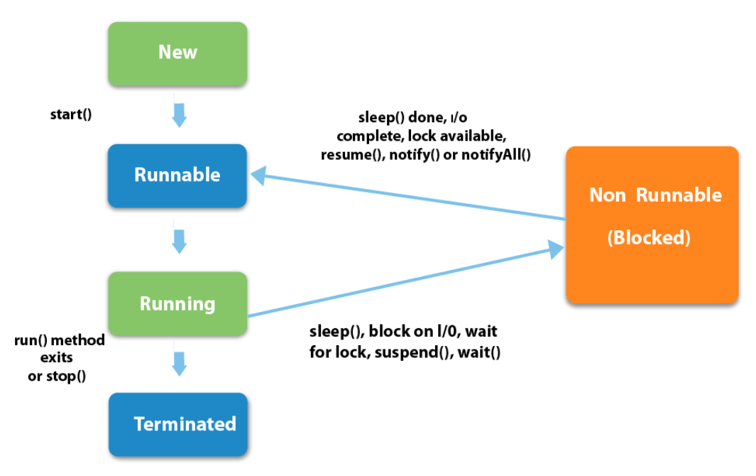

Slide 14
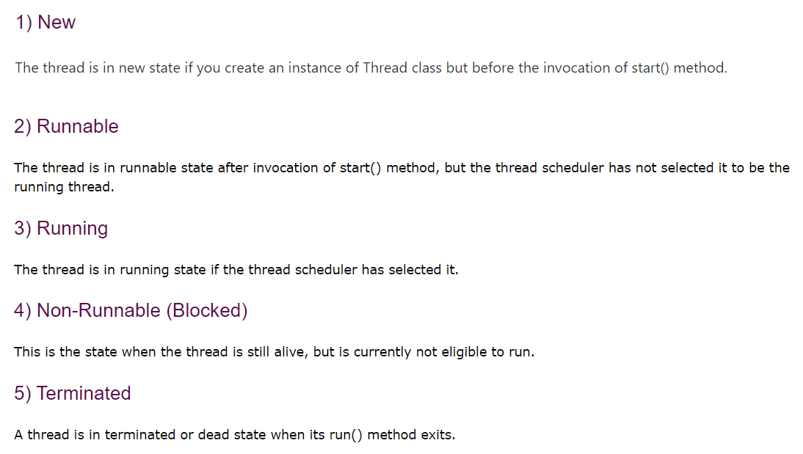

Slide 15
HOW TO CREATE A THREAD
There are two ways to create a thread:
1. By extending Thread class
2. By implementing Runnable interface.
Thread class:
Thread class provide constructors and methods to create and perform operations on a thread.Thread class extends Object class and implements Runnable interface.
Commonly used constructors of thread class:
Thread()
Thread(String name)
Thread(Runnable r)
Thread(Runnable r, String name)

Slide 16
RUNNABLE INTERFACE
The Runnable interface should be implemented by any class whose instances are intended to be executed by a thread. Runnable interface have only one method named run().
public void run(): is used to perform action for a thread.
Starting a thread:
start() method of Thread class is used to start a newly created thread. It performs following tasks:
A new thread starts(with new callstack).
The thread moves from New state to the Runnable state.
When the thread gets a chance to execute, its target run() method will run.
If you are not extending the Thread class,your class object would not be treated as a thread object.So you need to explicitely create Thread class object.We are passing the object of your class that implements Runnable so that your class run() method may execute.

Slide 17
THREAD SCHEDULER IN JAVA
Thread scheduler in java is the part of the JVM that decides which thread should run.
There is no guarantee that which runnable thread will be chosen to run by the thread scheduler.
Only one thread at a time can run in a single process.
The thread scheduler mainly uses preemptive or time slicing scheduling to schedule the threads.
Difference between preemptive scheduling and time slicing
Under preemptive scheduling, the highest priority task executes until it enters the waiting or dead states or a higher priority task comes into existence. Under time slicing, a task executes for a predefined slice of time and then reenters the pool of ready tasks. The scheduler then determines which task should execute next, based on priority and other factors.

Slide 18
SLEEP METHOD IN JAVA
The sleep() method of Thread class is used to sleep a thread for the specified amount of time.
Syntax of sleep() method in java
The Thread class provides two methods for sleeping a thread:
public static void sleep(long miliseconds)throws InterruptedException
public static void sleep(long miliseconds, int nanos)throws InterruptedException
As you know well that at a time only one thread is executed. If you sleep a thread for the specified time,the thread shedular picks up another thread and so on.

Slide 19
CAN WE START A THREAD TWICE
No. After starting a thread, it can never be started again. If you does so, an IllegalThreadStateException is thrown. In such case, thread will run once but for second time, it will throw exception.
Let's understand it by the example given below:
public class ThreadTwice extends Thread{
public void run(){
System.out.println("running..."); }
public static void main(String args[]){
ThreadTwice t1=new ThreadTwice();
t1.start();
t1.start(); } }
Output: running
Exception in thread “main” java.lang.IllegalThreadStateException.

Slide 20
WHAT IF WE CALL RUN() METHOD DIRECTLY INSTEAD START() METHOD?
Each thread starts in a separate call stack.
Invoking the run() method from main thread, the run() method goes onto the current call stack rather than at the beginning of a new call stack.
class CallRun extends Thread{
public void run(){
System.out.println("running..."); }
public static void main(String args[]){
CallRun t1=new CallRun();
t1.run();//fine, but does not start a separate call stack } }
Output: running…
As you can see in the above program that there is no context-switching because here t1 and t2 will be treated as normal object not thread object.

Slide 21
JOIN METHOD
The join() method waits for a thread to die. In other words, it causes the currently running threads to stop executing until the thread it joins with completes its task.
Syntax:
public void join()throws InterruptedException
public void join(long milliseconds)throws InterruptedException
The currentThread() method returns a reference to the currently executing thread object.

Slide 22
NAMING A THREAD
The Thread class provides methods to change and get the name of a thread. By default, each thread has a name i.e. thread-0, thread-1 and so on. By we can change the name of the thread by using setName() method. The syntax of setName() and getName() methods are given below:
public String getName(): is used to return the name of a thread.
public void setName(String name): is used to change the name of a thread.

Slide 23
PRIORITY OF A THREAD
Each thread have a priority. Priorities are represented by a number between 1 and 10. In most cases, thread schedular schedules the threads according to their priority (known as preemptive scheduling). But it is not guaranteed because it depends on JVM specification that which scheduling it chooses.
3 constants defined in Thread class:
public static int MIN_PRIORITY
public static int NORM_PRIORITY
public static int MAX_PRIORITY
Default priority of a thread is 5 (NORM_PRIORITY). The value of MIN_PRIORITY is 1 and the value of MAX_PRIORITY is 10.

Slide 24
DAEMON THREAD
Daemon thread in java is a service provider thread that provides services to the user thread. Its life depend on the mercy of user threads i.e. when all the user threads dies, JVM terminates this thread automatically.
There are many java daemon threads running automatically e.g. gc, finalizer etc.
You can see all the detail by typing the jconsole in the command prompt. The jconsole tool provides information about the loaded classes, memory usage, running threads etc.
Points to remember for Daemon Thread in Java
It provides services to user threads for background supporting tasks. It has no role in life than to serve user threads.
Its life depends on user threads.
It is a low priority thread.
Why JVM terminates the daemon thread if there is no user thread?
The sole purpose of the daemon thread is that it provides services to user thread for background supporting task. If there is no user thread, why should JVM keep running this thread. That is why JVM terminates the daemon thread if there is no user thread.
Note: If you want to make a user thread as Daemon, it must not be started otherwise it will throw IllegalThreadStateException.

Slide 25
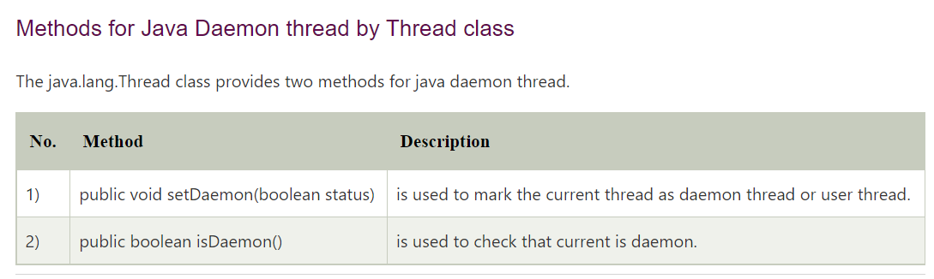

Slide 26
JAVA THREAD POOL
Java Thread pool represents a group of worker threads that are waiting for the job and reuse many times.
In case of thread pool, a group of fixed size threads are created. A thread from the thread pool is pulled out and assigned a job by the service provider. After completion of the job, thread is contained in the thread pool again.
Advantage of Java Thread Pool
Better performance It saves time because there is no need to create new thread.
Real time usage
It is used in Servlet and JSP where container creates a thread pool to process the request.

Slide 27
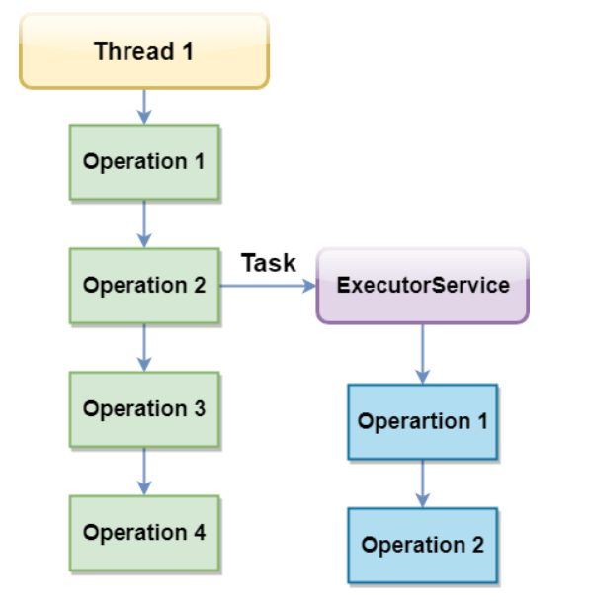
EXECUTORSERVICE
The Java ExecutorService is the interface which allows us to execute tasks on threads asynchronously. The Java ExecutorService interface is present in the java.util.concurrent package. The ExecutorService helps in maintaining a pool of threads and assigns them tasks. It also provides the facility to queue up tasks until there is a free thread available if the number

Slide 28
THREAD GROUP IN JAVA
Java provides a convenient way to group multiple threads in a single object. In such way, we can suspend, resume or interrupt group of threads by a single method call.
Note: Now suspend(), resume() and stop() methods are deprecated.
Java thread group is implemented by java.lang.ThreadGroup class.
A ThreadGroup represents a set of threads. A thread group can also include the other thread group. The thread group creates a tree in which every thread group except the initial thread group has a parent.
A thread is allowed to access information about its own thread group, but it cannot access the information about its thread group's parent thread group or any other thread groups.

Slide 29
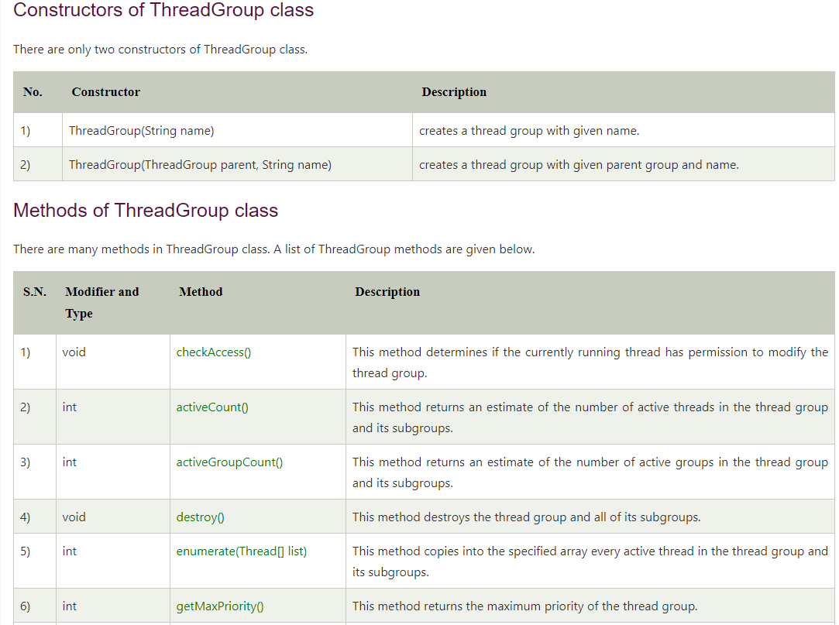

Slide 30
